Slide 1
Chapter 12 Multicasting and Multicast Routing Protocols
Introduction
Multicast addresses and IGMP
Multicast routing
Multicast routing protocol
MBONE

Slide 2
12.1 Introduction
IP Unicasting，IP单播通信
One source ←→ One destination in the Internet
unicast unicast
address address
IP Multicasting，IP多播通信
One source ←→ A group of destinations in the Internet
unicast multicast
address address
IP Broadcasting，IP广播通信
One source ←→ All of destinations in one IP network
unicast broadcast
address address

Slide 3
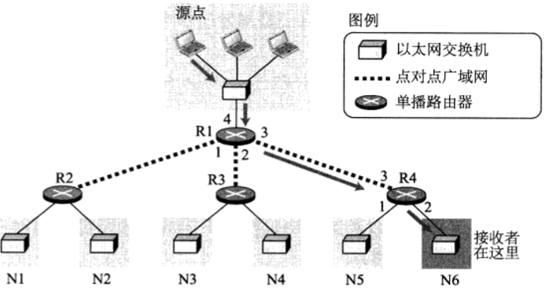
12.1 Introduction
IP Unicasting，IP单播通信
One source ←→ One destination in the Internet
unicast unicast
address address
Notes:
路由表为每个数据报定义了一个唯一的出口， 路由器仅从一个端口转发收到的分组

Slide 4
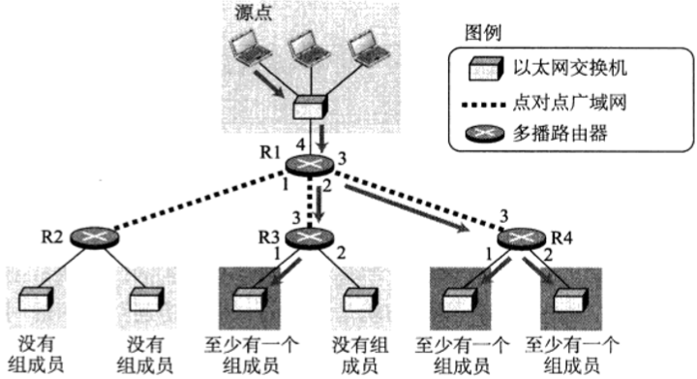
12.1 Introduction
IP Multicasting，IP多播通信
One source ←→ A group of destinations in the Internet
unicast multicast
address address
Notes:
路由器可以从多个端口转发收到的分组

Slide 5
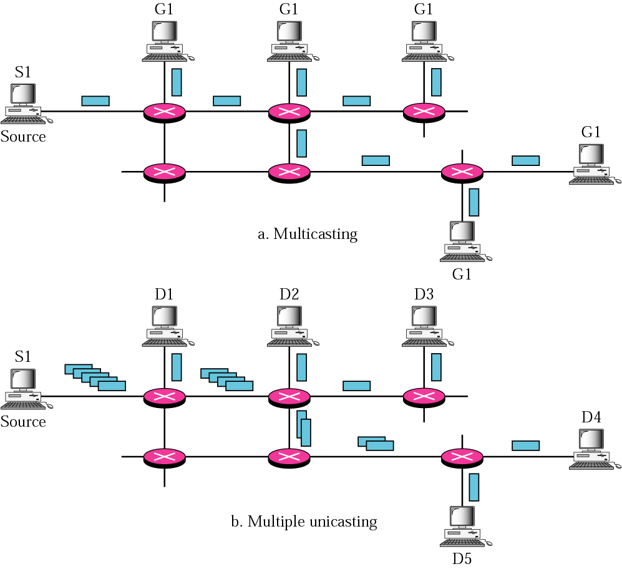
Multicasting vs. Multiple Unicasting
Less bandwidth
Less load of source
Less delay
More efficient
Notes:
多播时，两个路由器之间只有1个副本在传输，而多个单播中，两个路由器之间可能有多个副本在传输，如果有4个目的地， 在源端就需要4份数据；
时间上，单播模拟多播，源节点产生数据时就产生了时延，规模大时时延非常明显，效率太低；

Slide 6
Multicast Applications
Access to distributed database
访问分布式数据库
Information dissemination
信息传播
Dissemination of News
传播新闻
Teleconferencing
电视会议
Distance learning
远程学习
Notes:
分布式数据库，没有信息存储地点的先验信息，需要多播访问所有数据库；

Slide 7
12.2 Multicast Address and IGMP
Multicast address
Function: define a host group
IP multicast addresses
MAC multicast addresses
Mapping class D to Ethernet MAC address
IGMP
Internet Group Management Protocol
网际组管理协议
Notes:
在IPv4的定义中，就考虑了多播地址，D类地址， 在无分类地址中，也将相同的地址分给多播

Slide 8
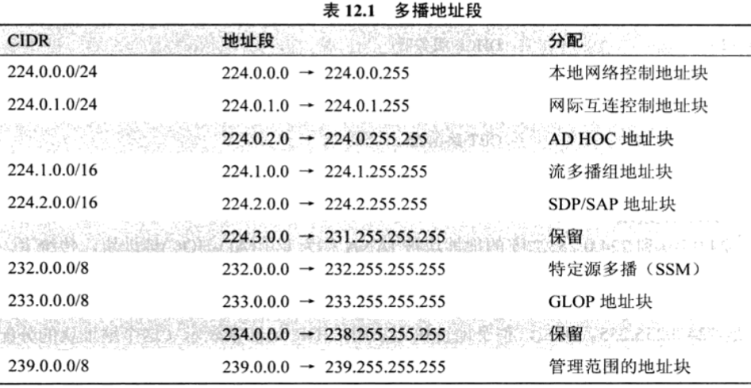
12.2.1 IP Multicast Address
Allocation: IANA（RFC 3171）
Class D: 224.0.0.0～239.255.255.255

Slide 9
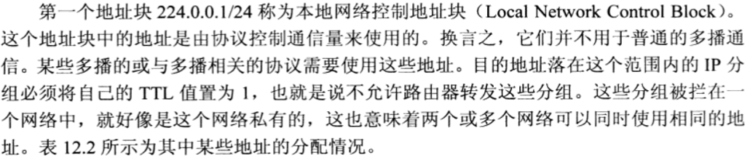
12.2.1 IP Multicast Address
Allocation: IANA（RFC 3171）
Class D: 224.0.0.0～239.255.255.255
Local Network Control Block
224.0.0.0/24: 224.0.0.0～224.0.0.255
Not be forwarded by router

Slide 10
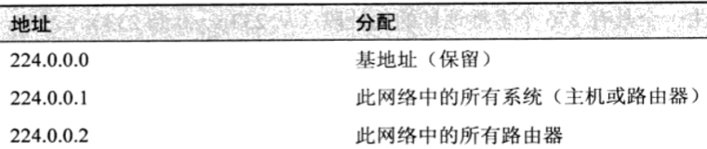
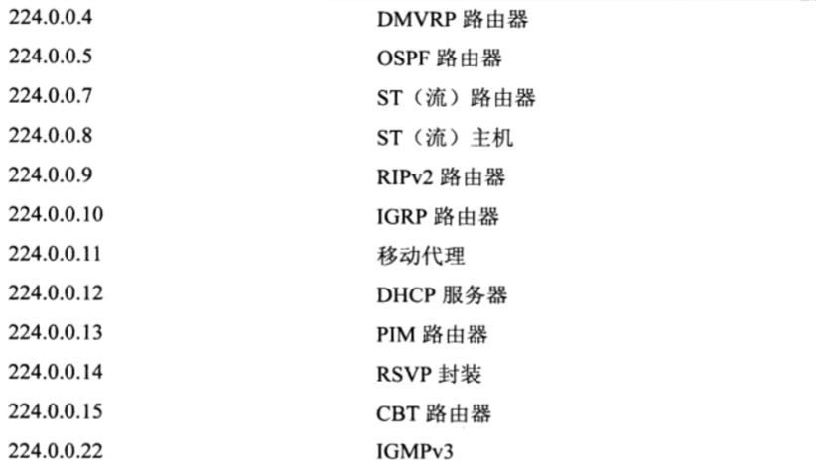
12.2.1 IP Multicast Address
224.0.0.0/24: 224.0.0.0～224.0.0.255
Not be forwarded by router

Slide 11
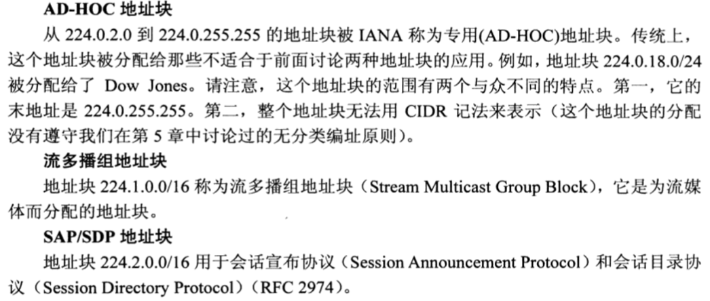
12.2.1 IP Multicast Address
224.0.2.0/24: 224.0.2.0～224.0.255.255
AD-HOC
224.1.0.0/16 Stream Multicast Group Block
Notes:
SSM地址块 232.0.0.0/8 用于特定源多播， IGMPv3

Slide 12
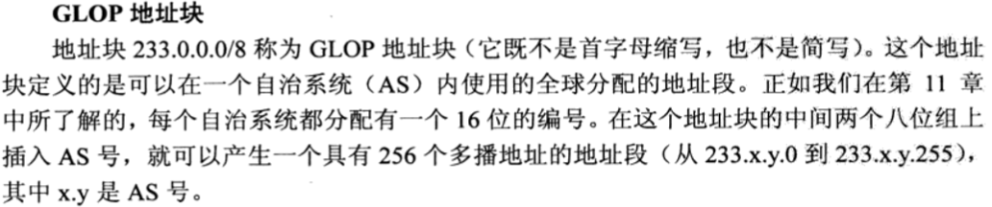
12.2.1 IP Multicast Address
233.0.0.0/8 GLOP Block
Area 1
Area 2
To
other
ASs
Area 0 (backbone)
Autonomous System

Slide 13
12.2.1 IP Multicast Address
Allocation: IANA（RFC 3171）
Administratively Scoped Address Block
239.0.0.0/8: 239.0.0.0～239.255.255.255
类似于私有IP单播地址（如10.0.0.0/8）
目的地址属于该地址的分组不应离开本区域

Slide 14
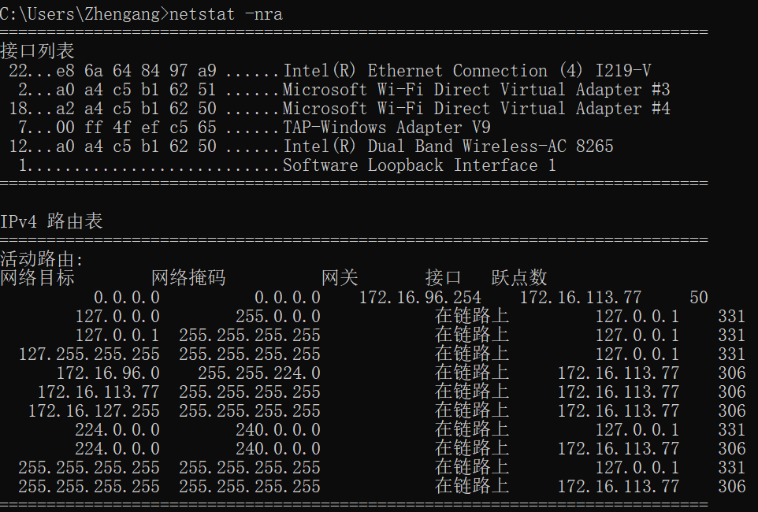
12.2.1 IP Multicast Address
Allocation: IANA（RFC 3171）
Class D: 224.0.0.0～239.255.255.255
Notes:
-n给出IP版本号，-r给出路由表，-a给出所有的地址

Slide 15
Data Link Layer
Physical multicast support
Most LANs support physical multicast addressing
Mapping IP multicast addresses to physical multicast addresses
Ethernet Multicast Address
01 : 00 : 5E : 00:00:00 – 01 : 00 : 5E : 7F:FF:FF

Slide 16
12.2.2 MAC Multicast Address
IEEE MAC address format
Standard Group MAC Addresses
Allocation: IEEE Registration Authority
IEEE 802.1D MAC Bridge Filtered MAC Group Addresses
01-80-C2-00-00-00～01-80-C2-00-00-0F
Standard MAC Group Addresses
01-80-C2-00-00-10～01-80-C2-FF-FF-FF
Others－http://standards.ieee.org/regauth
IP-mapped Ethernet MAC group addresses
01-00-5E-xx-xx-xx
bits
xxxxxxxxx1
xxxxxxxx
xxxxxxxx
xxxxxxxx
xxxxxxxx
xxxxxxxx

Slide 17
12.2.3 Mapping Class D to Ethernet MAC Address
Example
Problem: 不明确的MAC地址
IP多播地址:MAC多播地址＝2⁵ : 1＝32 : 1
例: 0x0100.5E01.0101表示32个IP多播地址
224.1.1.1, 224.128.1.1, 225.1.1.1, 225.128.1.1, … 239.128.1.1
Prefix
Multicast ID: 28 bits
1110
IP multicast address
239.255.0.1
Lost 5 bits
MAC
address
01-00-5E-7F-00-01
Prefix: 25 bits
Multicast ID: 23 bits

Slide 18
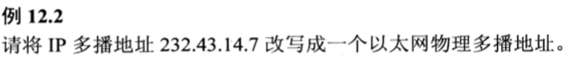
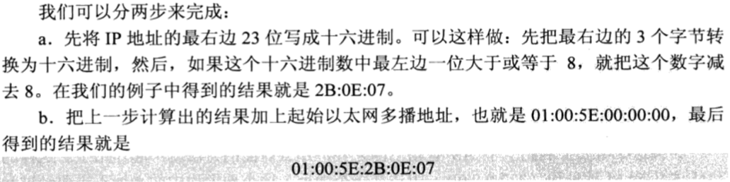
12.2.3 Mapping Class D to Ethernet MAC Address
Example

Slide 19
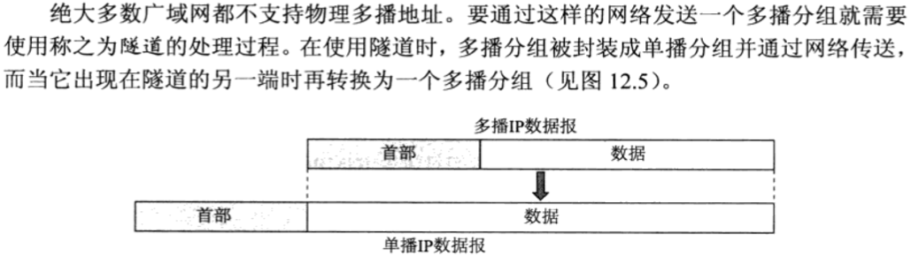
Data Link Layer
No physical multicast support
Most WANs DO NOT support physical multicast addressing
Using tunneling（隧道技术）to encapsulate the multicast IP packet in a unicast IP packet
Or be encapsulated as link layer broadcast

Slide 20
12.2.4 IGMP
Internet Group Management Protocol
网际组管理协议
Application Layer
Transport Layer
Network
Layer
ICMP
IGMP
IP
ARP
RARP
Network
Access
Layer
LANs
MANs
WANs

Slide 21
12.2.4 IGMP
Internet Group Management Protocol
网际组管理协议
Version 1: RFC 1112, Any source multicast
Version 2: RFC 2236
Version 3: RFC 3376, RFC 4604 Source-specific multicast
Function
Used between hosts and multicast routers on a single physical network
Help the multicast routers create and update a list of loyal members related to each router interface
Not a multicast routing protocol, but in conjunction with a multicast routing protocol to support IP multicasting
Notes:
多播路由器必须掌握一张多播组的列表，IGMP负责收集和解释一个网络中的组成员信息，它帮助多播路由器创建和更新与每一个路由器接口有关的loyal member的列表

Slide 22
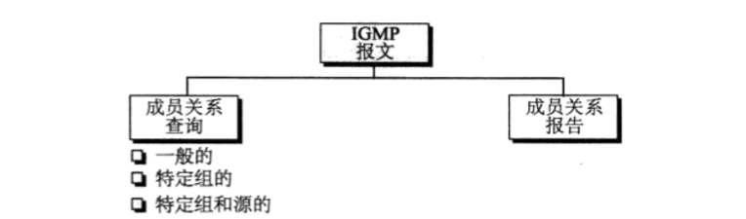
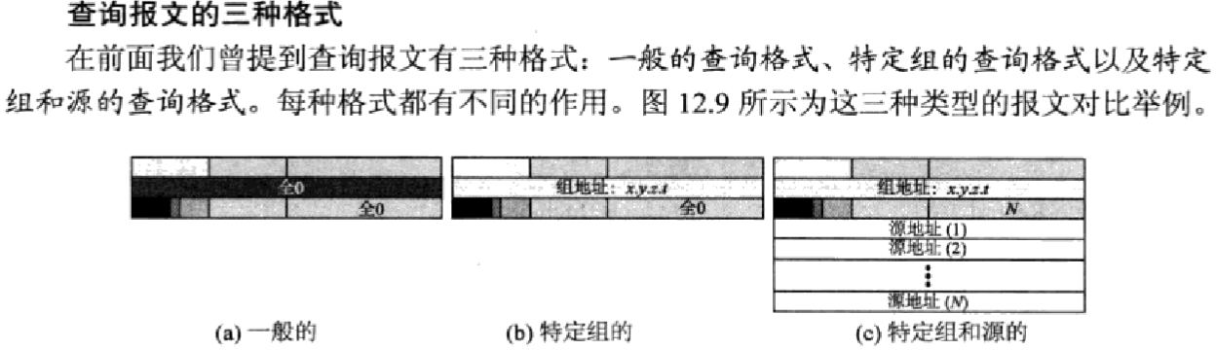
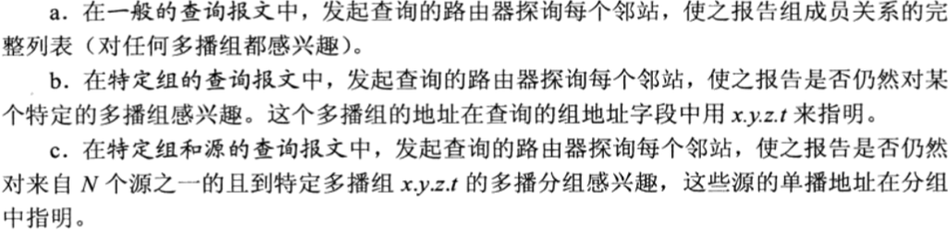
IGMP Format

Slide 23
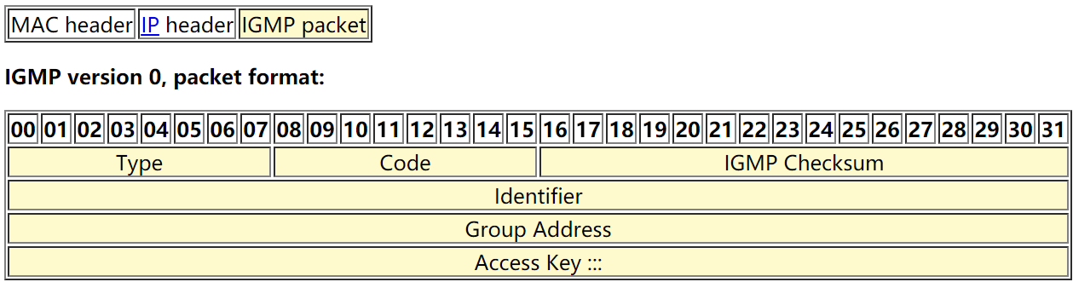
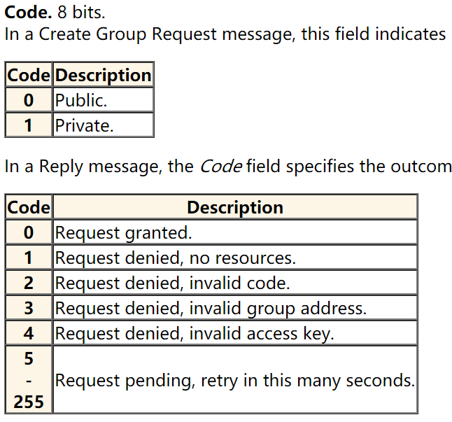
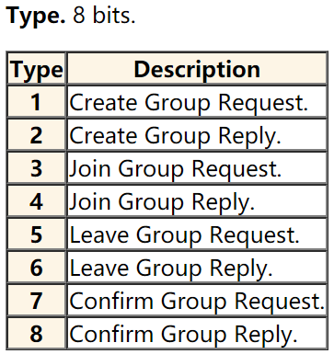
IGMP Format

Slide 24
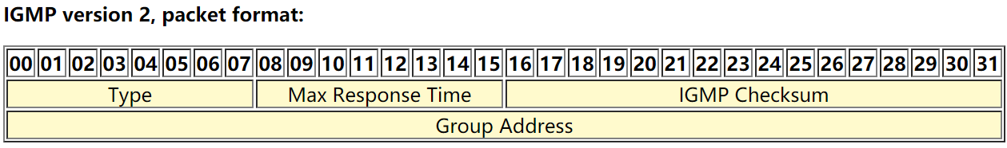
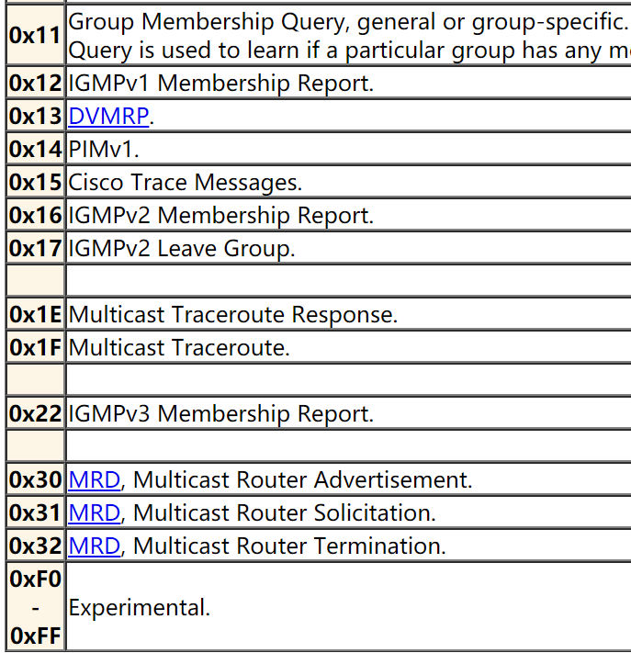
IGMP Format

Slide 25
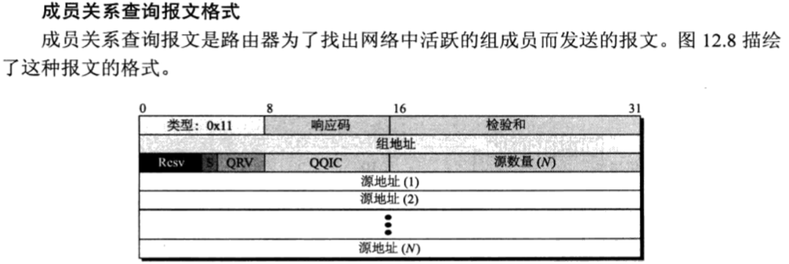

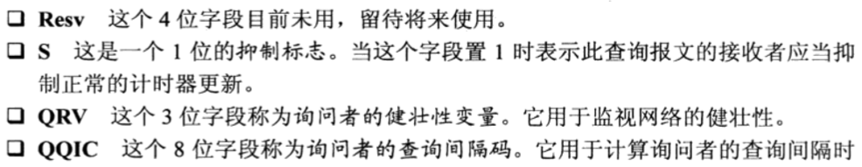
IGMP Format

Slide 26
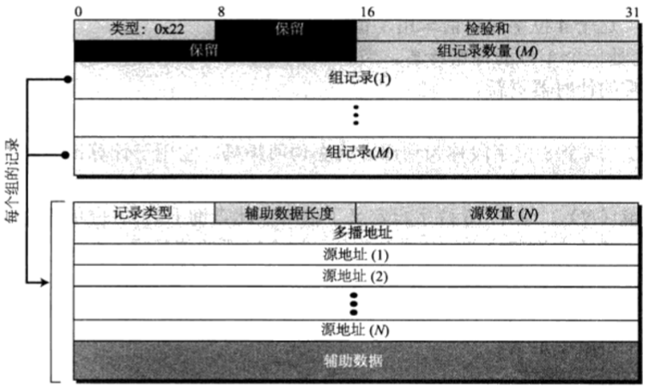
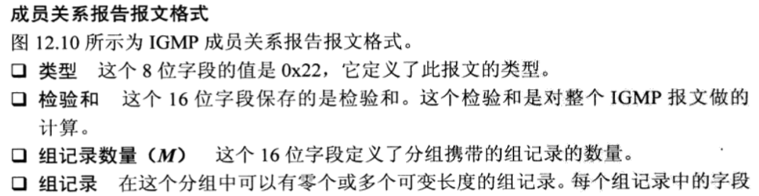
IGMP Format

Slide 27
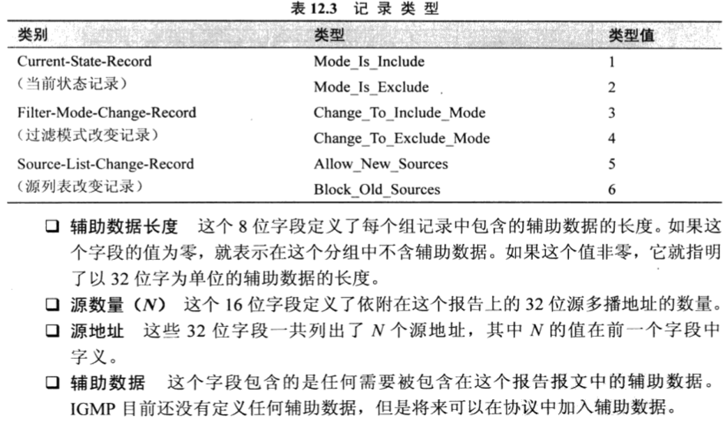
IGMP Format

Slide 28
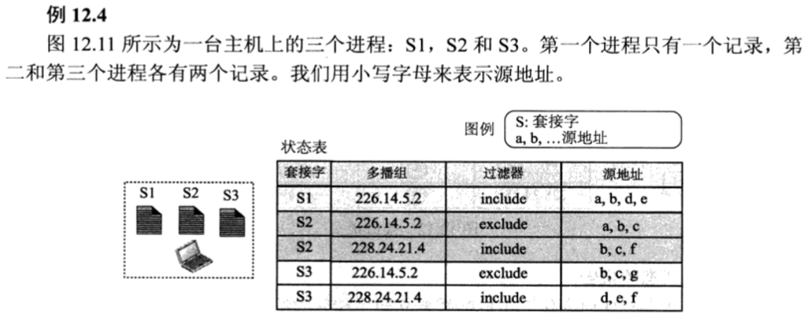
IGMP on Host
Notes:
Include 可接受的， exclude 除此之外的

Slide 29
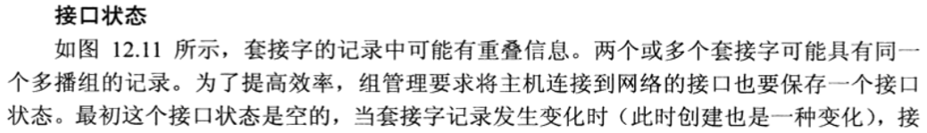
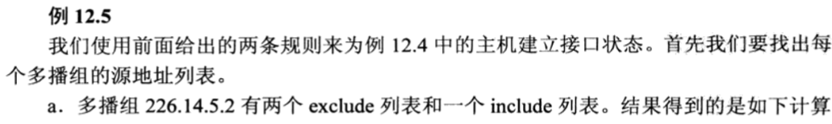
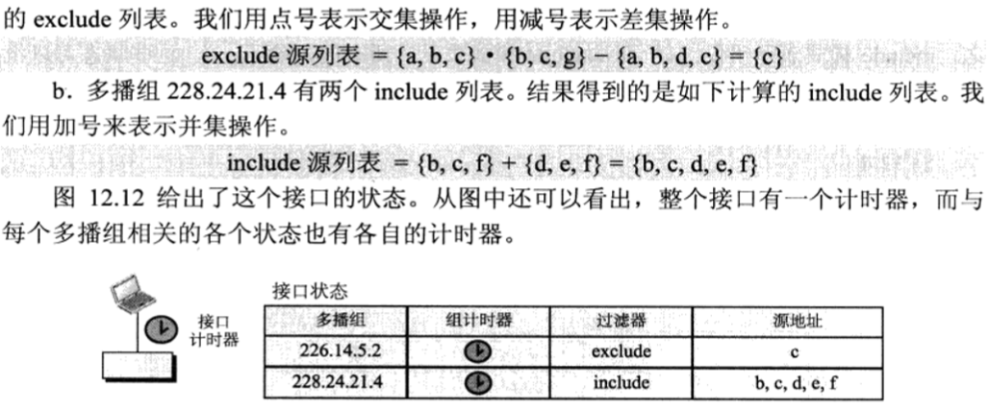
IGMP on Host
Notes:
Include 可接受的， exclude 除此之外的

Slide 30
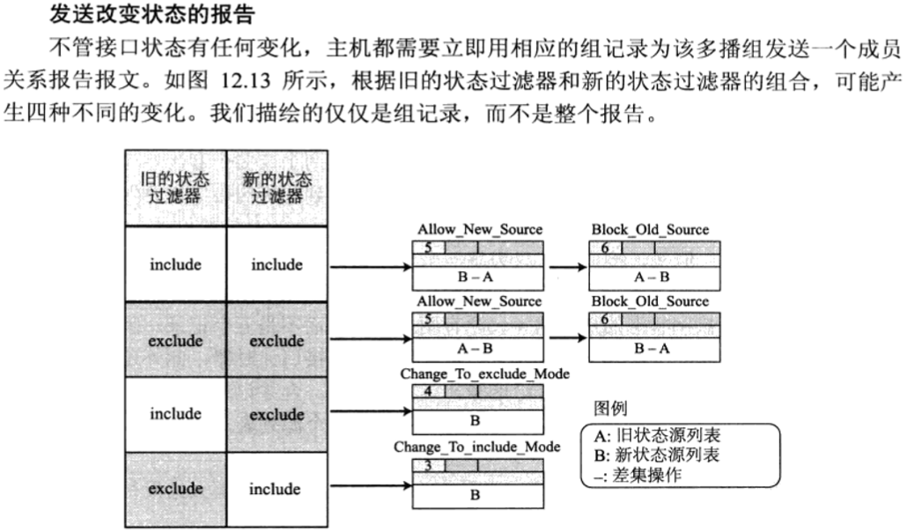
IGMP on Host
Notes:
Include 可接受的， exclude 除此之外的

Slide 31
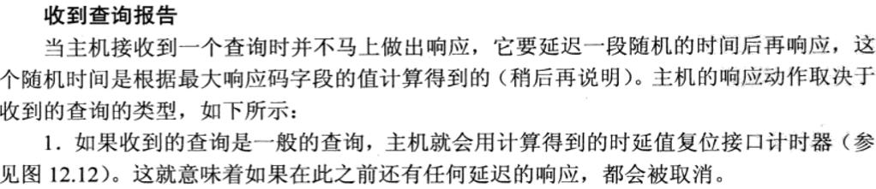
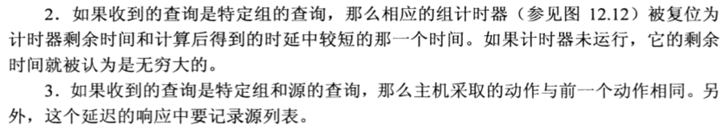
IGMP on Host
组计时器

Slide 32
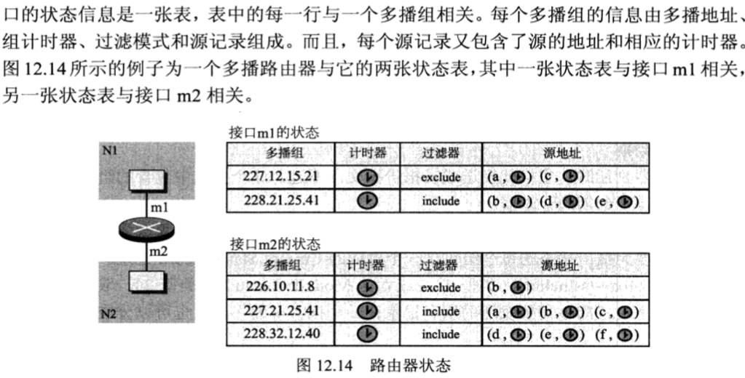
IGMP on Router

Slide 33
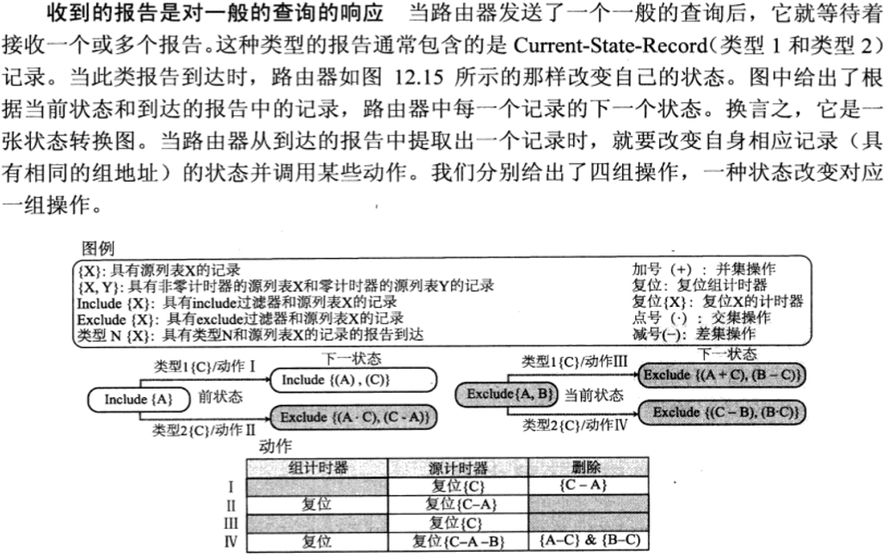
IGMP on Router

Slide 34
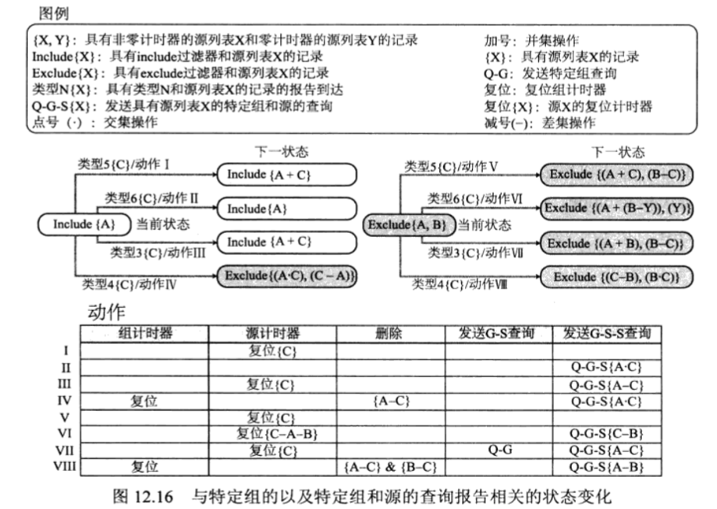
IGMP on Router

Slide 35
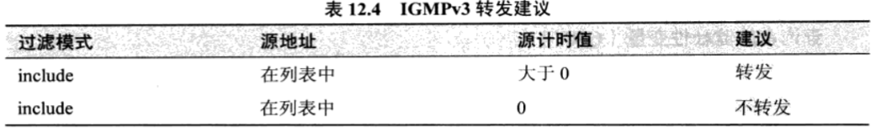
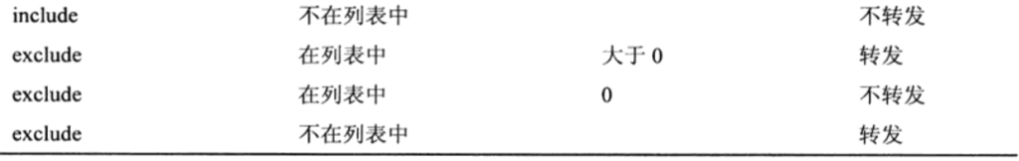
IGMP on Router
Notes:
第4行，源计时器超时了才被排除

Slide 36
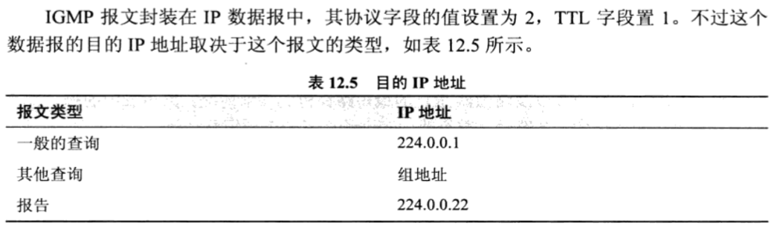
IGMP Operation
IGMP operates locally
Joining a group
Leaving a group
Monitoring membership
Notes:
TTL=1，仅在邻居间传播

Slide 37
12.3 Multicast Routing
Objectives of multicasting
Optimal routing
Multicast forwarding

Slide 38
12.3.1 Objectives of Multicasting
Every member of the group should receive one, and only one copy of the multicast packet
Nonmembers must not receive a copy
There must be no loops in routing, that is, a packet must not visit a router more than once
The path traveled from the source to each destination must be optimal

Slide 39
12.3.2 Optimal Routing: Shortest Path Trees
Shortest path tree in unicast routing
Each router has a routing table that defines a shortest path to possible destinations
Root: each router itself
Leaf: possible destinations
Shortest path tree in multicast routing
Each involved router needs to construct a shortest path tree for each group
Two types of trees: source-based, group-shared
Notes:
最佳域间路由选择的结果是找到一棵最短路径树，单播和多播都是如此，但树的数目和构成则不同，如果有n个组就需要n个最短路径树

Slide 40
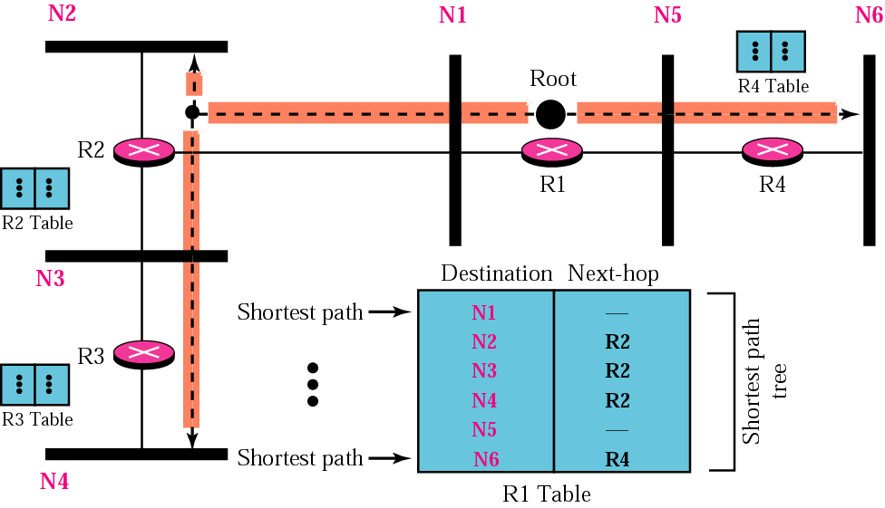
Shortest Path Tree in Unicast Routing
Notes:
单播路由下，每个路由器都有一张到达每个目的地的最短路径表

Slide 41
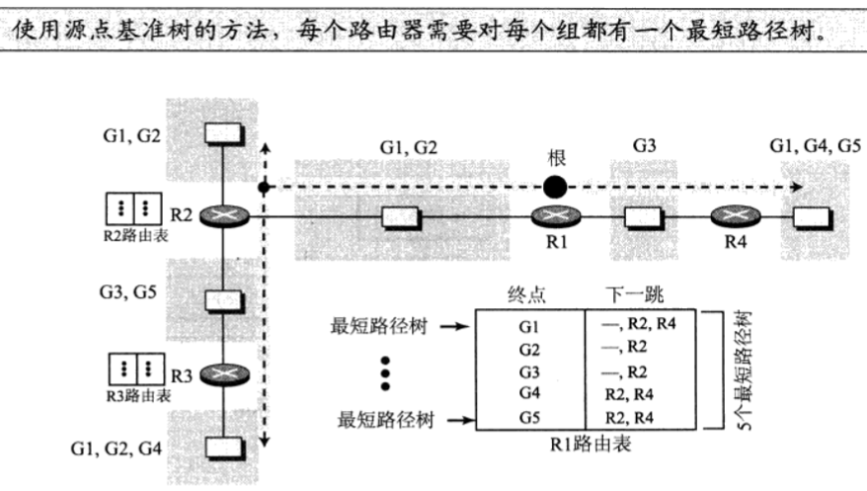
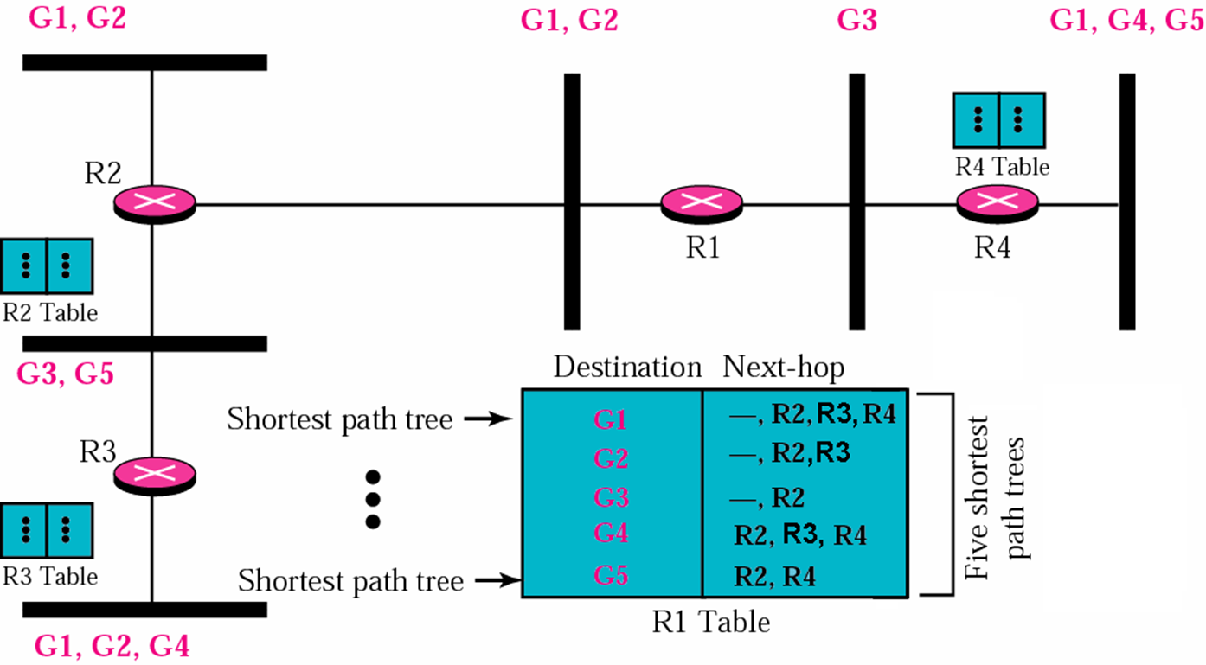
Shortest Path Tree in Multicast Routing
Notes:
G1- G5共5个分组， R1中如果收到目的地为G1的分组，则需要给其所在网络，然后R2，R4，随着组数的增加而增加

Slide 42
Source-Based Tree
192.1.1.1
假设：A、B、C在多播组224.1.1.1中
(192.1.1.1, 224.1.1.1)
主机A
A
R1
R3
R1
R2
R4
R6
B
R5
B
R3
R5
C
R3
R1
R5
主机B
主机C
192.2.2.2
192.3.3.3
A
C
(192.1.1.2, 224.1.1.1)

Slide 43
Discuss: (S, G)
（S, G）：最短路径树（SPT）
树根：多播组G的信息源（S）
在具体的多播路由协议中，S通常指源子网
树叶：多播组G的接收成员
（S, G）是单向树
多播信息流只能沿树的下行方向传播
典型的多播路由协议
DVMRP：单播D-V路由选择的扩展
MOSPF：单播L-S路由选择的扩展
PIM-DM：根据需要使用单播路由选择协议

Slide 44
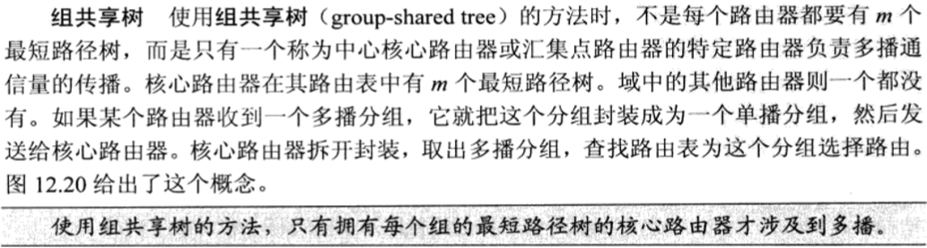
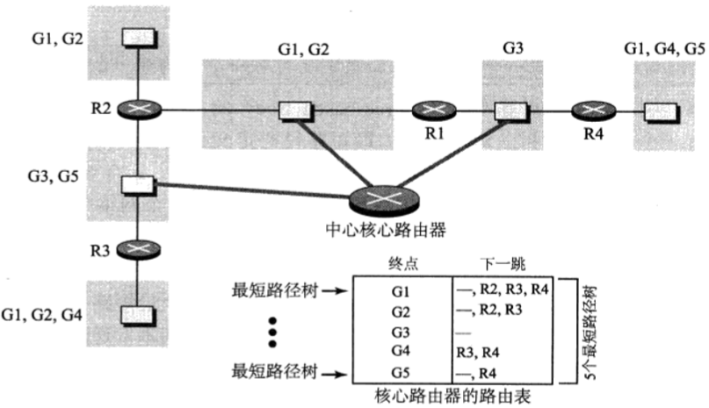
Shortest Path Tree in Multicast Routing
Notes:
G1- G5共5个分组， R1中如果收到目的地为G1的分组，则需要给其所在网络，然后R2，R4，随着组数的增加而增加

Slide 45
Group-Shared Tree: RPT
192.1.1.1
192.5.5.5
假设：A、B、C、D、E在多播组224.2.2.2中
主机A
主机E
192.4.4.4
根
主机D
R1
R2
R4
R6
(*, 224.2.2.2)
R3
R5
R4
R2
R6
R3
主机B
主机C
R1
E
D
B
R5
192.2.2.2
192.3.3.3
A
C

Slide 46
Bidirectional RPT
192.1.1.1
192.5.5.5
假设：A、B、C、D、E在多播组224.2.2.2中
主机A
主机E
192.4.4.4
根
主机D
R1
R2
R4
R6
(*, 224.2.2.2)
R3
R5
R4
上行
R2
R6
R3
下行
主机B
主机C
R1
E
D
B
R5
192.2.2.2
192.3.3.3
A
C

Slide 47
Unidirectional RPT
192.1.1.1
192.5.5.5
假设：A、B、C、D、E在多播组224.2.2.2中
主机A
主机E
192.4.4.4
根
主机D
R1
R2
R4
R6
多播源如何
将多播信息
流送至根?
(*, 224.2.2.2)
R3
R5
R4
R2
R6
R3
下行
主机B
主机C
R1
E
D
B
R5
192.2.2.2
192.3.3.3
A
C

Slide 48
Unidirectional RPT + Source-Based Tree
192.1.1.1
192.5.5.5
假设：A、B、C、D、E在多播组224.2.2.2中
主机A
主机E
192.4.4.4
根
主机D
R1
R2
R4
R6
(A, 224.2.2.2)
(*, 224.2.2.2)
R3
R5
A
R4
R1
R2
R6
R3
主机B
主机C
R2
R1
E
D
B
R5
192.2.2.2
192.3.3.3
R4
A
C

Slide 49
Unidirectional RPT + Unicast Tunneling
192.1.1.1
192.5.5.5
假设：A、B、C、D、E在多播组224.2.2.2中
主机A
主机E
单播
隧道
192.4.4.4
根
主机D
R1
R2
R4
R6
(*, 224.2.2.2)
R3
R5
R4
R2
R6
R3
主机B
主机C
R1
E
D
B
R5
192.2.2.2
192.3.3.3
A
C

Slide 50
Discuss: RPT
RPT:（*, G）
树根：多播组G的汇集点（RP）路由器
静态指定RP：管理员根据需要指定
动态选取RP：最高IP地址，RP哈希算法（RFC 2362）
树叶：多播组G的接收成员
多播组G的信息源S不一定在（*, G）上
多播信息源S在RPT上：适合使用双向RPT
多播信息源S不在RPT上：适合使用单向RPT
典型的多播路由协议
CBT：双向RPT（＋单播隧道：信息源不在RPT上）
PIM-SM：单向RPT＋有源树
—— 汇集点路由器的最短路径树

Slide 51
Shortest Path Tree in Multicast Routing
Source-Based Tree
源点基准树 or 有源树
Each combination of source and group has a single tree
Ex.: N groups and M sources → N x M trees
Notation: (S, G) —— S＝多播源IP地址，G＝多播组地址
Group-Shared Tree
组共享树 or 共享树
Each group shares the same tree
Steiner tree, rendezvous-point tree（汇集点树，RPT）
Ex.: N groups → N trees
Notation: (*, G) —— *＝所有的多播源，G＝多播组地址
Notes:
将指定点集合中的所有点连通，且边权总和最小的生成树称为最小斯坦纳树（Minimal Steiner Tree）

Slide 52
有源树 vs. 共享树
树根与多播源
有源树的树根就是多播源
无需静态指定或动态选取，多播源一定在有源树上
共享树的树根不是多播源
需静态指定或动态选取，多播源不一定在共享树上
对多播路由器的影响
共享树对多播路由器的资源消耗少于有源树
有源树个数随（多播源，多播组）的增加而增加
共享树个数随多播组的增加而增加
多播数据流的传输延迟
共享树的多播数据流的传输延迟大于有源树
有源树是从多播源到所有组成员的最短路径树
共享树只是从汇集点到所有组成员的最短路径树

Slide 53
Pruning, 剪枝
剪掉树中没有多播接收成员分支的过程，有时效性
例：
源网络S，组G
剪枝后的（S，G）
（S，G）
S
S
R1
R1
R2
R1
R2
R3
R3
R4
R5
R3
R4
R5
R6
接收站A，组G
R6

Slide 54
Grafting, 嫁接
剪掉的分支上如果又出现了多播接收成员，则将其快速接回树上的过程
例：
嫁接前的
（S，G）
嫁接后的
（S，G）
源网络S，组G
S
S
R1
R1
R1
R2
R3
R3
R4
R5
R3
R4
R6
接收站B，组G
接收站A，组G
R6

Slide 55
Pruning and Grafting
To create a multicast shortest path tree that supports dynamic membership changes
To make multicasting more efficient

Slide 56
12.3.3 Multicast Forwarding
Unicast forwarding
Use the destination IP address in the IP packet to lookup the unicast routing table to decide whether and how to forward
Multicast forwarding
Reverse path forwarding: 逆向路径转发, RPF
Use the source IP address in the IP packet to lookup the multicast routing table or the unicast routing table to decide whether to forward
Outgoing interface list: 输出接口列表
Constructed by the multicast tree to perform the forwarding
→ Multicast forwarding cache

Slide 57
RPF Check Example 1
源151.10.3.21
的多播分组
R1的路由表
网络 | 接口
151.10.0.0/16
198.14.32.0/24 | S0
204.1.16.0/24 | E0
S1
分组到达错误
接口
→丢弃
S0
S1
S2
R1
E0
PIM、CBT：单播路由表
DVMRP：多播路由表

Slide 58
RPF Check Example 2
R1的路由表
网络 | 接口
151.10.0.0/16
198.14.32.0/24 | S0
204.1.16.0/24 | E0
源151.10.3.21
的多播分组
S1
分组到达正确
接口
→按输出接口表转发
S0
S1
S2
R1
E0

Slide 59
Multicast Forwarding Cache
Multicast forwarding cache entry
Multicast tree, incoming interface: RPF check
Outgoing interface list
Example: Cisco router
(*, 224.1.1.1), 00:03:54/00:02:59, RP 10.1.5.1
Incoming interface: Serial0, RPF nbr 10.1.5.1
Outgoing interface list:
Serial1, Forward/Sparse, 00:01:43/00:02:11
Serial2, Forward/Sparse, 00:03:54/00:02:06
(171.68.37.121/32, 224.1.1.1), 00:00:25/00:02:53
Incoming interface: Serial0, RPF nbr 10.1.5.1
Outgoing interface list:
Serial2, Forward/Sparse, 00:00:25/00:02:35

Slide 60
Chapter 12 Multicasting and Multicast Routing Protocols
Introduction
Multicast addresses and IGMP
Multicast routing
Multicast routing protocol
MBONE

Slide 61
12.4 Multicast Routing Protocol
Multicast routing protocols
Source-Based Tree
(S, G)
Group-Shared Tree
(*, G)
PIM
MOSPF
DVMRP
PIM-DM
PIM-SM
CBT
Link State
链路状态协议
Dense Mode, DM
密集模式协议
Sparse Mode, SM
稀疏模式协议

Slide 62
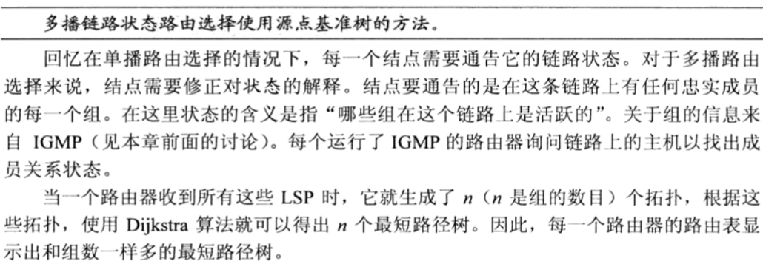
LS, DM and SM Protocols
LS（Link State，链路状态）协议
通过扩散多播链路状态信息形成（S, G）

Slide 63
12.4.1 MOSPF
Multicast Open Shortest Path First
多播开放最短路径优先，RFC 1584，RFC 1585
An enhancement of OSPF v2
Uses IGMP to monitor multicast group membership
Floods the group-membership-LSA (type 6) throughout the routing domain
A separate shortest-path tree is built on demand for each [source network, multicast group] combination
Feature
L-S, IGP, (S, G), LS
Forwarding cache entry
local group database – IGMP
link state database – OSPF type 6 LSA
Notes:
MOSPF是数据驱动的协议，收到具有给定源节点和分组的数据报时，才构造Dijkstra最短树

Slide 64
12.4.2 DVMRP
Distance Vector Multicast Routing Protocol
距离向量多播路由选择协议，RFC 1075
Combine many features of RIP with the truncated reverse path broadcasting (TRPB, 截断反向路径广播) algorithm
Uses IGMP to exchange routing messages
Source network address, source network mask, hop count
Maintains a multicast routing table to keep track of the return paths to the source of multicast packets
Feature
D-V, IGP, (S, G), DM
Forwarding cache entry
Multicast routing table

Slide 65
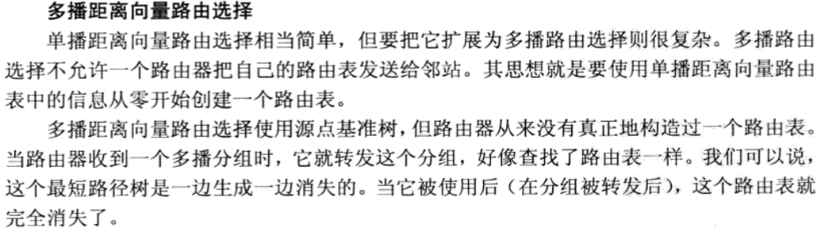
DVMRP
Distance Vector Multicast Routing Protocol
距离向量多播路由选择协议，RFC 1075
Notes:
四个策略

Slide 66
(1)Flooding，洪泛
Flooding is related to both multicasting and broadcasting
Method
Forwards a packet out of all of its interfaces except the one from which the packet came
Feature
Provide broadcasting
Create loops and traffic jams: several copies of the same packet are circulated

Slide 67
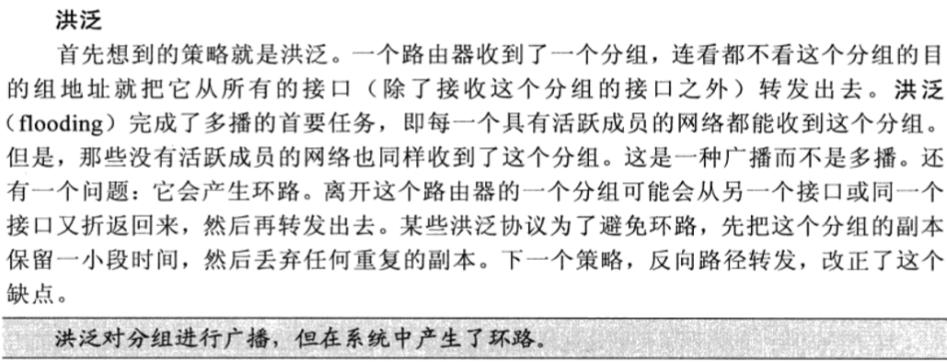
(1)Flooding，洪泛
Distance Vector Multicast Routing Protocol
距离向量多播路由选择协议，RFC 1075
Notes:
四个策略

Slide 68
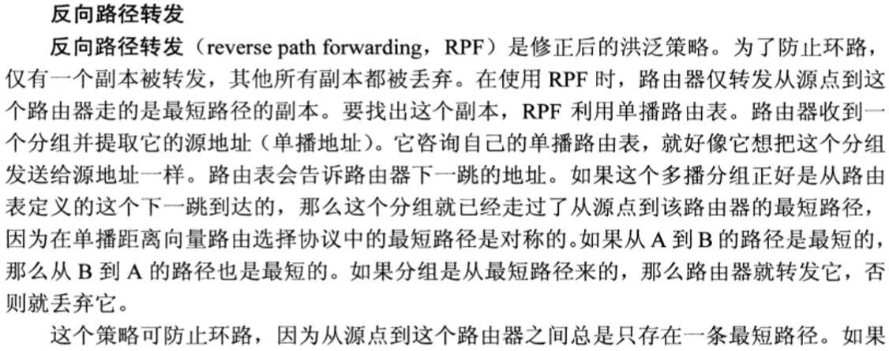
(2) RPF
Distance Vector Multicast Routing Protocol
距离向量多播路由选择协议，RFC 1075
Notes:
四个策略

Slide 69
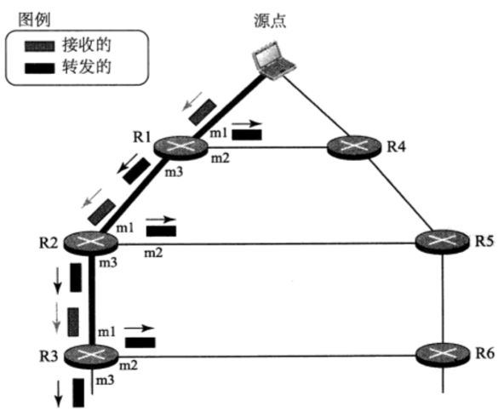
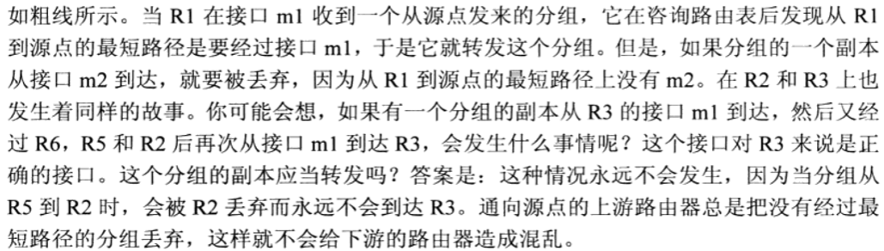
(2) RPF
Notes:
四个策略

Slide 70

(3)RPB
反向路径广播
Notes:
四个策略

Slide 71

(3)RPB
反向路径广播
Notes:
一个网络只能从特定的父路由器那边接收来自特定源点的多播分组，父路由器可以是与源点之间具有最短路径的路由器，如果有多个则取IP地址最小的一个

Slide 72

(4)RPM
反向路径多播

Slide 73
12.4.3 CBT
Core-Based Tree
有核树，RFC 2189 (version 2, not be compatible with v1)
May use a separate multicast routing table or the underlying unicast routing table
Feature
Protocol independent
Bidirectional (*, G) + Unicast Tunneling, SM
Forwarding cache entry
CBT join messages: <group, downstream interface, upstream interface>
Be gleaned from the routing table
- the next hop to the specified core address.

Slide 74

12.4.3 CBT
核心基干树协议

Slide 75

12.4.3 CBT
核心基干树协议

Slide 76
12.4 Multicast Routing Protocol
Multicast routing protocols
Source-Based Tree
(S, G)
Group-Shared Tree
(*, G)
PIM
MOSPF
DVMRP
PIM-DM
PIM-SM
CBT
Link State
链路状态协议
Dense Mode, DM
密集模式协议
Sparse Mode, SM
稀疏模式协议

Slide 77
LS, DM and SM Protocols
LS（Link State，链路状态）协议
通过扩散多播链路状态信息形成（S, G）
DM（Dense Mode，密集模式）协议
PUSH原理：假设网络中的每个子网内至少有一个多播数据流的接收站
类比：电台广播或电视广播
特性：（S, G），周期性的扩散和剪枝
SM（Sparse Mode，稀疏模式）协议
PULL原理：假设网络中初始没有多播接收站，除非显式加入
类比：有线电视
特性：（*, G），周期性的显式加入和剪枝

Slide 78
12.4.4 PIM-DM
Protocol Independent Multicast – Dense Mode
协议无关多播－密集模式，RFC 3973
Uses the underlying unicast routing information base or a separate multicast-capable routing information base
No to exchange routing messages
No multicast routing table
Feature
Protocol independent
(S, G), DM
Forwarding cache entry
PIM Hello, Prune, and Graft messages: build (S, G)
Unicast routing table: perform RPF check

Slide 79

12.4.4 PIM-DM
Protocol Independent Multicast – Dense Mode
协议无关多播－密集模式，RFC 3973
Uses the underlying unicast routing information base or a separate multicast-capable routing information base
No to exchange routing messages
No multicast routing table

Slide 80
PIM-SM
Protocol Independent Multicast – Sparse Mode
协议无关多播－稀疏模式，RFC 4601
Uses the underlying unicast routing information base or a separate multicast-capable routing information base
No to exchange routing messages
No multicast routing table
Feature
Protocol independent
Unidirectional (*, G) + (S, G), SM
Forwarding cache entry
PIM Hello, Register, and Join/Prune messages: build (*, G)
Unicast routing table: perform RPF check

Slide 81

PIM-SM
Protocol Independent Multicast – Sparse Mode
协议无关多播－稀疏模式，RFC 4601
Uses the underlying unicast routing information base or a separate multicast-capable routing information base
No to exchange routing messages
No multicast routing table

Slide 82

12.5 MBONE
MBONE: multicast backbone, 多播主干
单播源
S G
R1 R2
单播目的
Notes:
把多播分组封装在单播分组中

Slide 83
12.6 Summary
多播地址
IP多播地址：地址空间，是否可路由
IP－MAC多播地址映射：方法，问题
IGMP：功能
多播路由选择
多播树：分类、特性、剪枝、嫁接
多播转发：多播转发缓存、RFP机制
多播路由协议
分类、特性
MBONE：概念

